Slide 1
Preliminary Findings on The Impact of COVID on College Activity
Based on Google Query Data

Slide 2
Several organizations report that due to the pandemic, college enrollments are much lower than normal
Perhaps this implies that all college settings are under-enrolled, but perhaps there is a change in the enrollments in certain kinds of schools.
Also, it might be that financial hardship is responsible for the changes, but perhaps not.

Slide 3
It might seem that students interested in college will find programs that are remote in order to avoid Covid disruptions, and that there might be an increase in those programs.
Instead of polling the enrollments of online programs, we can check Google for queries of “college online” to infer whether interest in online programs has grown or not since Covid.

Slide 4
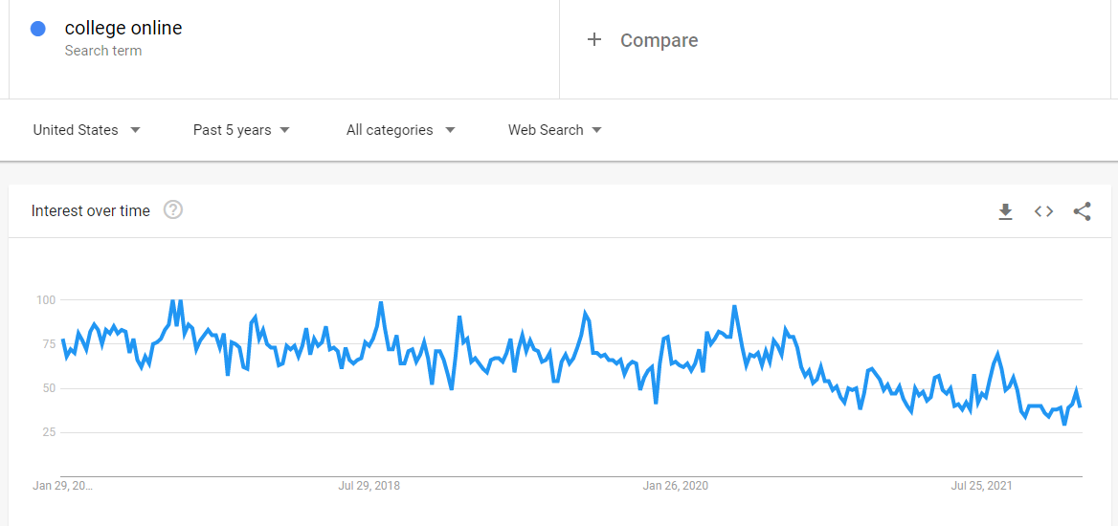
Interest in Online College

Slide 5
Interest in Online College
That result seems to indicate that interest in online programs declined with covid, rather than increased.
Perhaps this is attributable to a more significant drop in interest in college altogether, that the greater appeal of online programs was unable to overcome.
If so, then there would perhaps also be a heightened college dropout rate for the same reason.

Slide 6
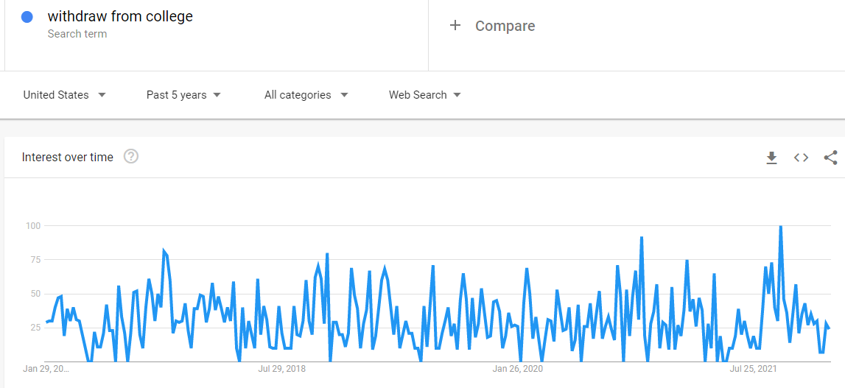


Withdrawing from College

Slide 7
Withdrawing from College
That result seems to imply, although not very strongly, that interest in withdrawing from college increased with covid, which might be expected if covid made attending college unreasonably difficult.
However, it might be more informative to examine the relative responses to difficulty, considering the two alternatives: doing better in college, vs. withdrawing from college, as shown in the two comparison searches below: the first in the two years since covid, and the second the three years previously.

Slide 8
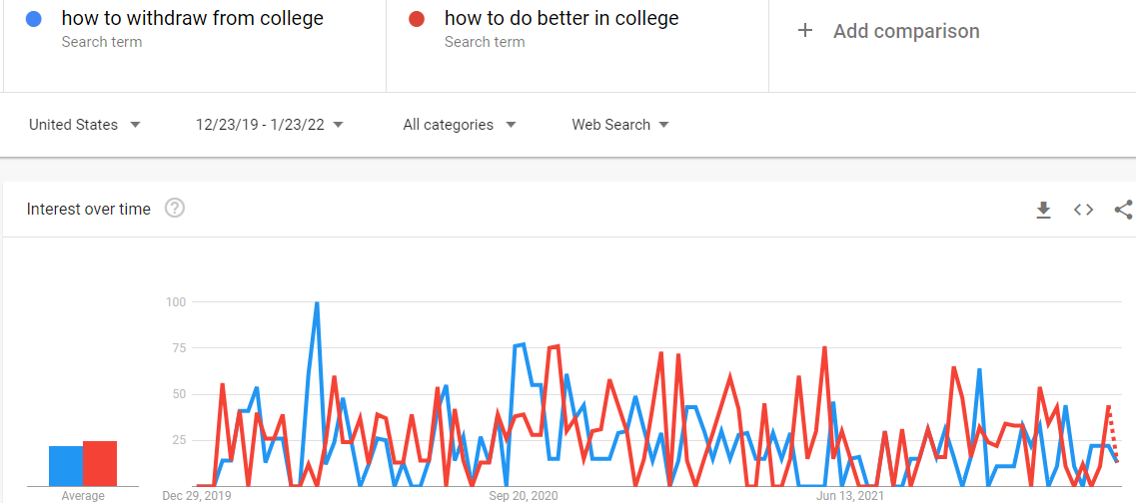

Comparing “withdraw from college” to “Do Better in College”

Slide 9
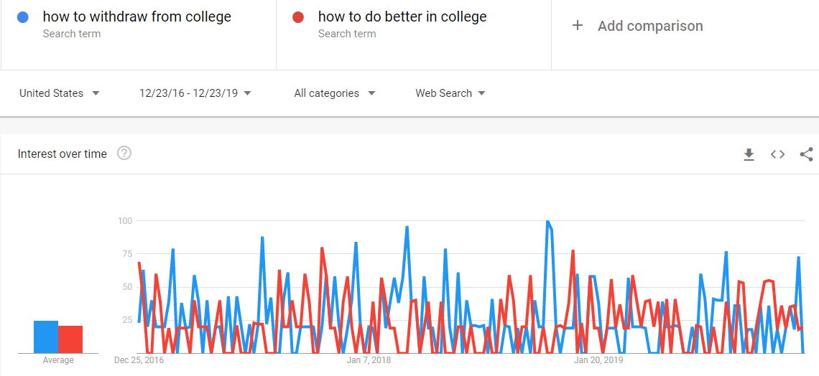

Comparing “withdraw from college” to “Do Better in College”

Slide 10
Those results suggest that for students in school, as a result of covid and the additional difficulties in attending school, there was an increase in efforts to do better in school rather than withdrawing from school.

Slide 11
If college enrollment dropped due to Covid, it seems reasonable to connect that with the additional financial strain from the pandemic.
If covid affected the earning power of the population, it would likely have a disproportionate effect on the lower income population, and that might be reflected in a stark decrease in community college enrollment due to covid.

Slide 12
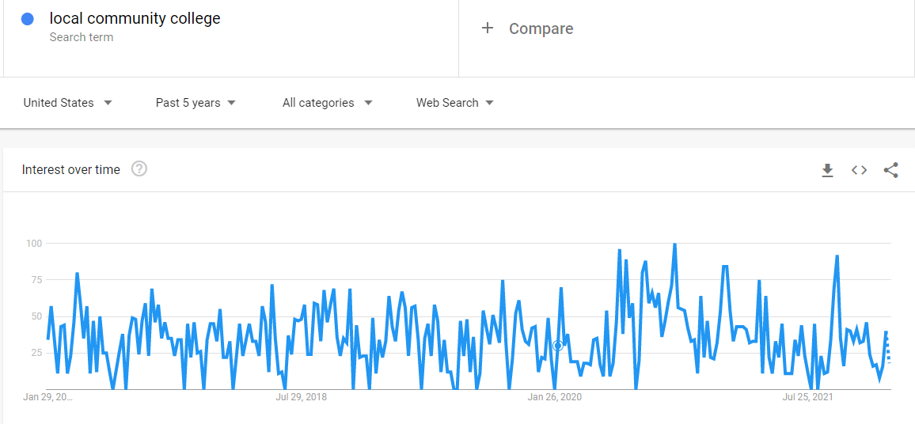
Interest in Community College

Slide 13
Interest in Community College
That result seems to indicate that interest in community college rose with covid!
Naturally, interest in community college isn’t the same as actual enrollment in community college, but it seems significant.

Slide 14
FAFSA application
If Covid is responsible for deterring students from attending college, due to financial hardship, there ought to be an increase in FAFSA applications. (FAFSA is the federal government financial aid application.)

Slide 15
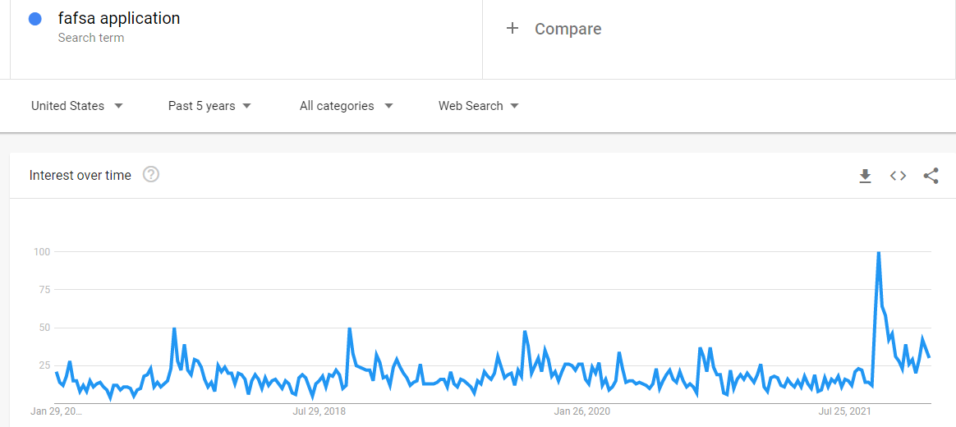
FAFSA application

Slide 16
FAFSA application
That spike is interesting, as it occurs in early October 2021, when the FAFSA opens for the following year. Perhaps it suggests that the popular attitude is to apply to college in greater force than previously, making any dip in applications only temporary.
On the other hand, there ought to be a commensurate spike in interest in other, miscellaneous financial aid over the same time, but the following graph shows that actually there has been a steady decline since covid.

Slide 17
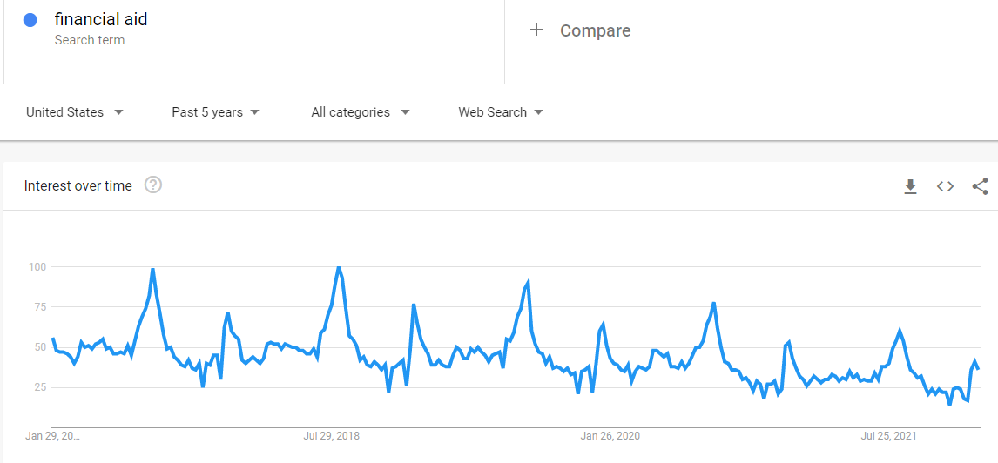
Financial Aid

Slide 18
Conclusion:
Although the direct polling of all colleges for their enrollment numbers is likely to reveal the effect of Covid on enrollment, we can study indirect indicators of underlying motivators from Google, and try to determine:

Slide 19
Conclusion:
whether online programs are positively affected;
Not really- there seems to be a decline in interest
whether community colleges are specifically affected;
Surprisingly, they seem to garner greater interest since Covid
whether finances have inspired prospective students to look for more financial aid;
Hard to determine: FAFSA maybe yes, but other aid- no
whether students tend to drop out of school more readily due to the pandemic:
Evidently, not really- possibly greater dropout rate, but even greater efforts in overcoming obstacles

